Slide 1
Diapering Resources Committee Meeting
Dr. Alee Moore, Director of Capacity Building
March 9, 2023

Slide 2
Federal grants are vital to paying for and balancing the costs of community assets and services.

Slide 3
Nevada has historically failed to get its fair share of federal grant funding.
In FFY20, Nevada received approximately
$800 less per person than the national average.
Federal Grants Per Capita, Nevada Rankings among all States and Territories:
51ST
INCOME SECURITY
& SOCIALSERVICES
55TH
HEALTH
54TH
EDUCATION
45TH
OVERALL
Sources:
1. “Federal Grants Per Capita, 2019.” Federal Funds Information for the States.
2. “Federal Grants Performance in Nevada.” Guinn Center March 2021.
43RD
ENERGY,
ENVIRONMENT
& NATURAL
RESOURCES
50TH
AGRICULTURE
46TH
COMMUNITY
& REGIONAL
DEVELOPMENT

Slide 4
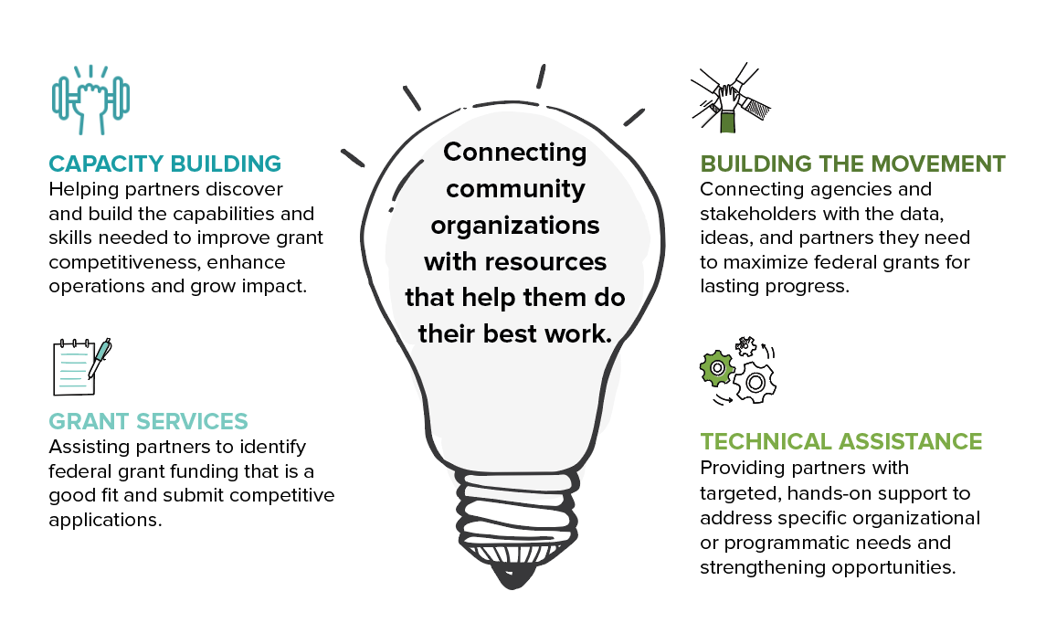
Thanks to generous donors and local government partnerships, services are available at no- or low-cost to all participants.

Slide 5
Questions?

Slide 6
WWW.NEVADAGRANTLAB.ORG

